Slide 1
Application of Machine Learning in Predicting
the Transportation Rate on a Spaceship Titanic
Team:
Le Dao
Dang Minh Nhu Nguyen
Dr.Cristina Tortora
Class: MATH 151 - Spring 2022
Notes:
Nhu

Slide 2

Problem and Goal
Problem:
The Spaceship Titanic was an interstellar passenger liner launched a month ago. While rounding Alpha Centauri en route to its first destination—the torrid 55 Cancri E—the unwary Spaceship Titanic collided with a spacetime anomaly hidden within a dust cloud. Even though the ship stayed intact, almost half of the passengers were transported to an alternate dimension!
Goal:
The goal of the challenge is to obtain the optimal algorithm to forecast which passengers were transported by the anomaly and to assist rescuers in locating missing passengers
Notes:
Nhu
The Spaceship Titanic was an interstellar passenger liner launched a month ago. While rounding Alpha Centauri en route to its first destination the unwary Spaceship Titanic collided with a spacetime anomaly hidden within a dust cloud. Even though the ship stayed intact, almost half of the passengers were transported to an alternate dimension!

Slide 3
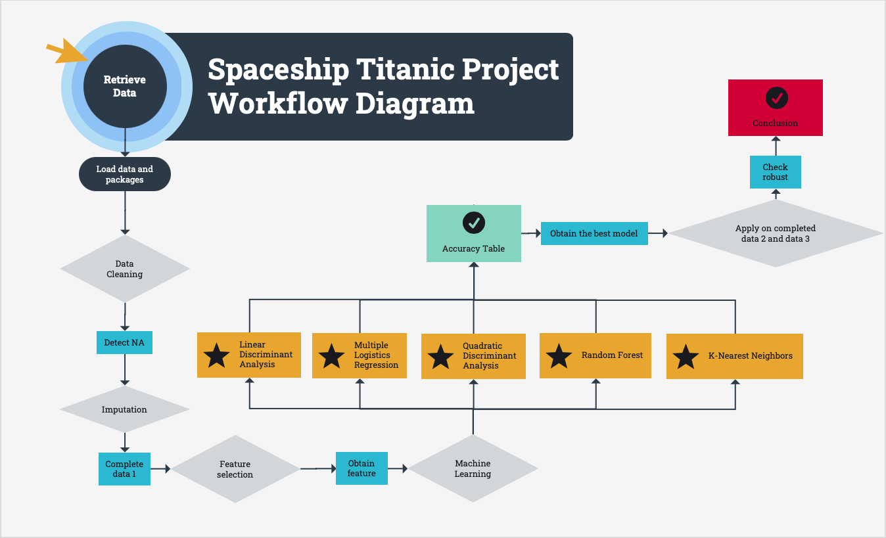
Notes:
Nhu:
After identifying the problem and goals, we then make a workflow diagram to make sure we cover everything in order to complete the project.
Starting by retrieve the data then load all data and packages into R. Performing Data cleaning and exploration, then imputation, feature selection then building the model using machine learning algorithm LDA, QDA, MLG, RF and KNN. We then output the accuracy score table afterward to have a comparison between the models. Next we would like to check if our best model’s robust by apply it to another 2 dataset then we give our conclusion

Slide 4

Materials
Programming language: R
Method:
Classifications
Dataset
Name: Spaceship Titanic
Source: Kaggle
Number of observations: 8693
Missing data: 2324
Number of variables : PassengerID, HomePlanet, CryoSleep, Cabin, Destination, Age, VIP, RoomService, FoodCourt, Shopping Mall, Spa, VRDeck, Name, Transported.
Notes:
Le

Slide 5
Methodology - Loading Data
Loading the data
Specified: na.string = “”
If not, R will not recognize the empty values in csv file as NA
Checking the structure of all the columns
Convert CryoSleep, VIP from character to logical
Convert Transported, HomePlanet, Destination from character to factor
Notes:
Le

Slide 6
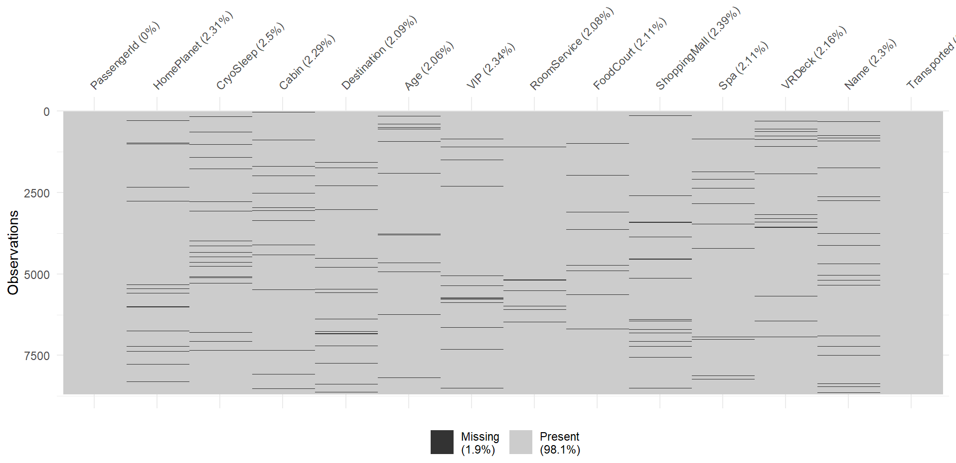
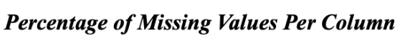
Methodology - Data Cleaning
Missing values
26% of the observations are missing
All features have missing values except for “Passenger ID” and “Name”
Approximately 2% of observations is missing from each column
Notes:
Le
Because 26% of missing values are quite significant, we don’t want to eliminate them, instead we will choose to do further step to fill in these values

Slide 7
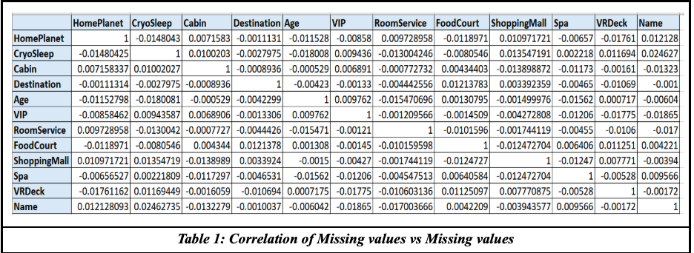
Methodology - Data Cleaning
Notes:
Nhu:
We then compute the correlation table of missing values versus missing values. From the result table we can see that all values are very small which mean that it is most likely our data is MAR

Slide 8
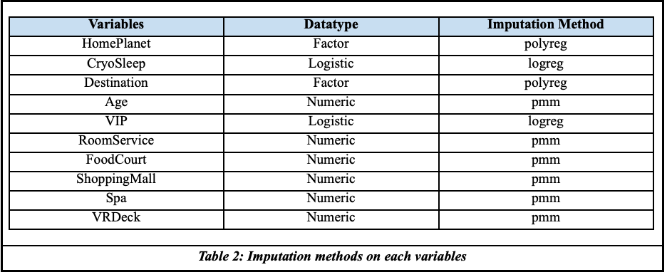
Methodology- Imputation
mice() and complete() from package mice.
Notes:
Nhu
From the previous step, it is most likely that our missing values are MAR, we then perform imputation using mice() and complete() come from package mice. With different data type, mice will apply different methods in order to impute those missing values. For example, for factor datatype of variable homeplanet, a polytomous logistic regression method will be used. VIP with logistic data type will be imputed as logistic regression. pmm for other numeric data type mean predictive mean matching

Slide 9
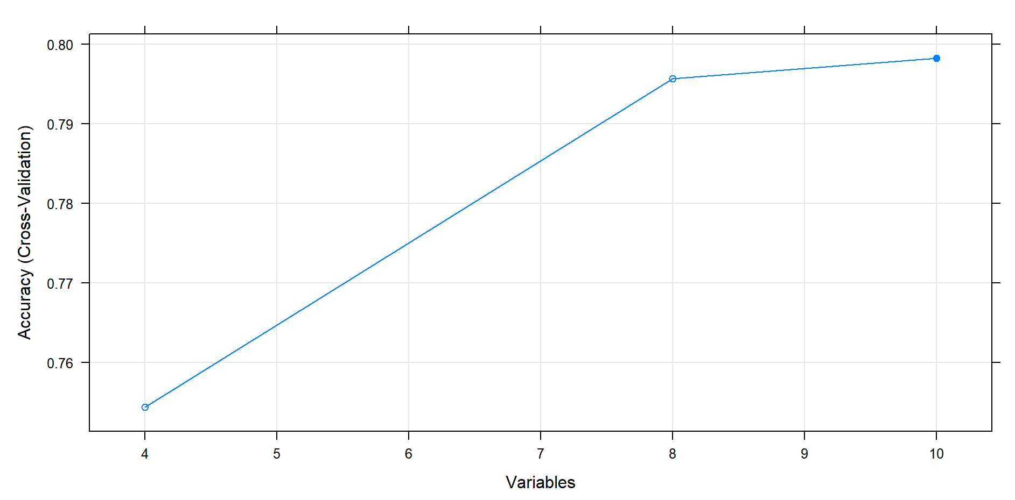
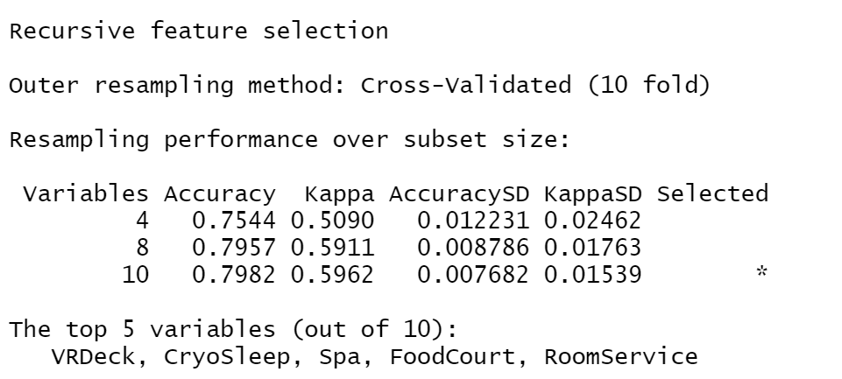
Methodology- Feature Selection
Recursive Feature Elimination (RFE):
Determine which variables are most effective in measuring the response variable
Conduct Backward Selection Procedure
Build Model based on all and Calculate the relevance of each feature
Implement RandomForest criterion to rank the variables and drop the least crucial features
8 features is selected
Notes:
Le
Kappa is the ratio of the proportion of times that the appraisers agree (corrected for chance agreement) to the maximum proportion of times that the appraisers could agree (corrected for chance agreement).
https://support.minitab.com/en-us/minitab/18/help-and-how-to/quality-and-process-improvement/measurement-system-analysis/how-to/attribute-agreement-analysis/attribute-agreement-analysis/interpret-the-results/all-statistics-and-graphs/kappa-statistics/

Slide 10
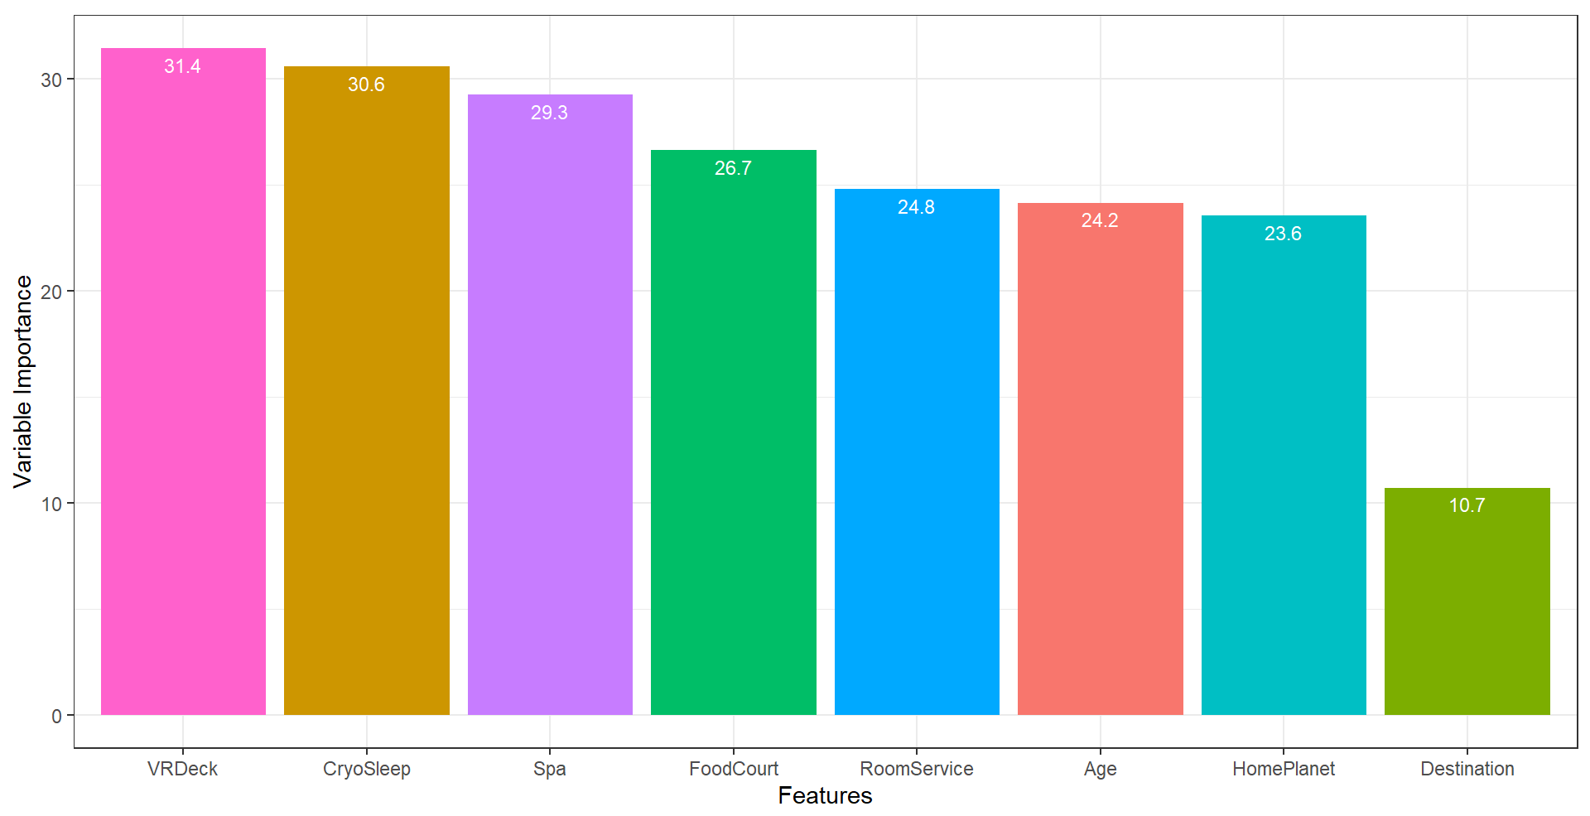
Methodology- Feature Selection
Recursive Feature Elimination (RFE):
See the 8th most important feature by using varImp()
Notes:
Le

Slide 11
Methodology- Models
Response Variable “Transported”:
Categorical → Predicting by Classification
Binary:
Multiple Logistic Regression
Linear Discriminant Analysis (LDA)
Quadratic Discriminant Analysis (QDA)
K-nearest Neighbor (KNN)
Random Forest
Notes:
Le

Slide 12
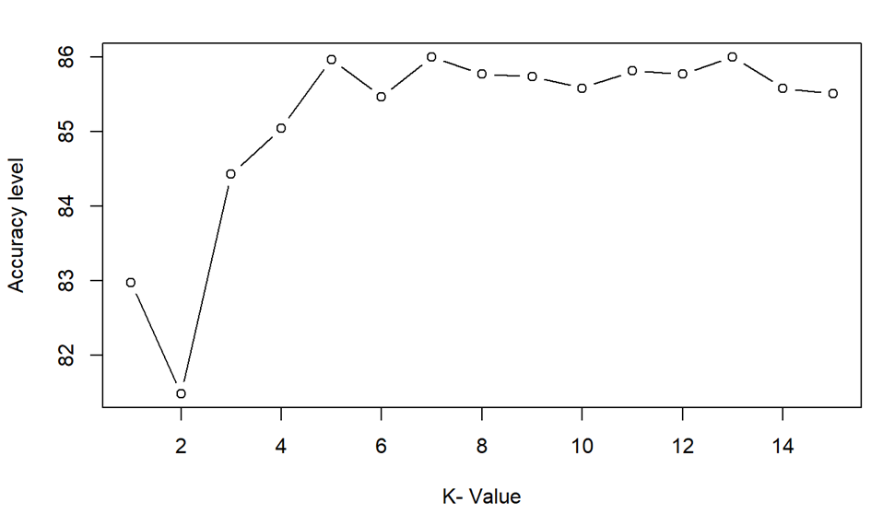
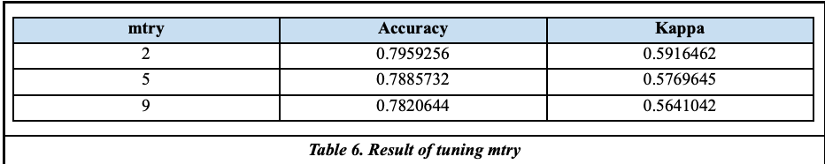
Methodology - Classification
Randomly sampling the data with 70% on train set and the rest on test set.
General classification steps:
Converting the structure
Build the models
Tune parameters (KNN and Random Forest)
Build confusion matrix
MSE
Notes:
Le
LDA & QDA:
“Transported” is changed back to logical.
KNN: Create dummy variable for HomePlannet and Destination with data type is numeric since KNN does not work with factor data type
Random Forest:
“Transported” is changed back to factor.

Slide 13
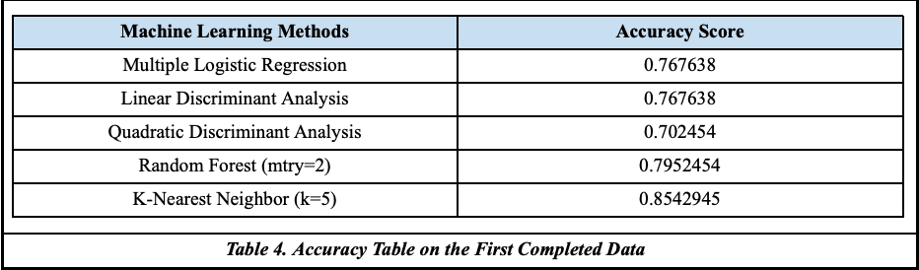
Methodology - Accuracy Comparison
Notes:
Nhu:
We then generating a complete table of accuracy score for easier comparison. With k=5, KNN gave the best accuracy score out of all 5 tests

Slide 14
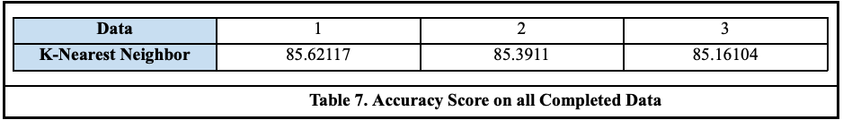
Methodology - Robust
Apply KNN onto another 2 datasets
Notes:
Nhu: However, we are not sure if it is a robust model or not, then we take a further steps on to 2 other dataset which also using mice to complete and apply KNN onto them. The result show that since all of them are approximately around 85%. KNN is most likely robust.

Slide 15

Conclusion
KNN is the most optimic model out of all 4.
KNN is robust for all 3 datasets.
KNN provide approximately 85% accuracy score.
Notes:
Nhu:
In the final conclusion, KNN is the most optimic model out of all 4. It is robust and provide approximately 85% accuracy score which mean that if we apply our technique along with KNN model, approximately 85 out of 100 time our model will predict correctly that whether or not the passengers are transported to another dimension successfully.

Slide 16
THANK YOU
Q&A

